Slide 1

Democratizing Trading
Amine Roudani
Alessandro Massaad
MSOR
MSOR
Martina Paez Berru
MSBA

Slide 2
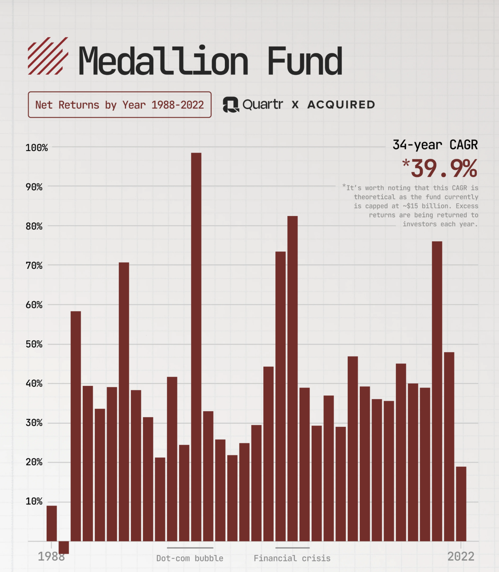
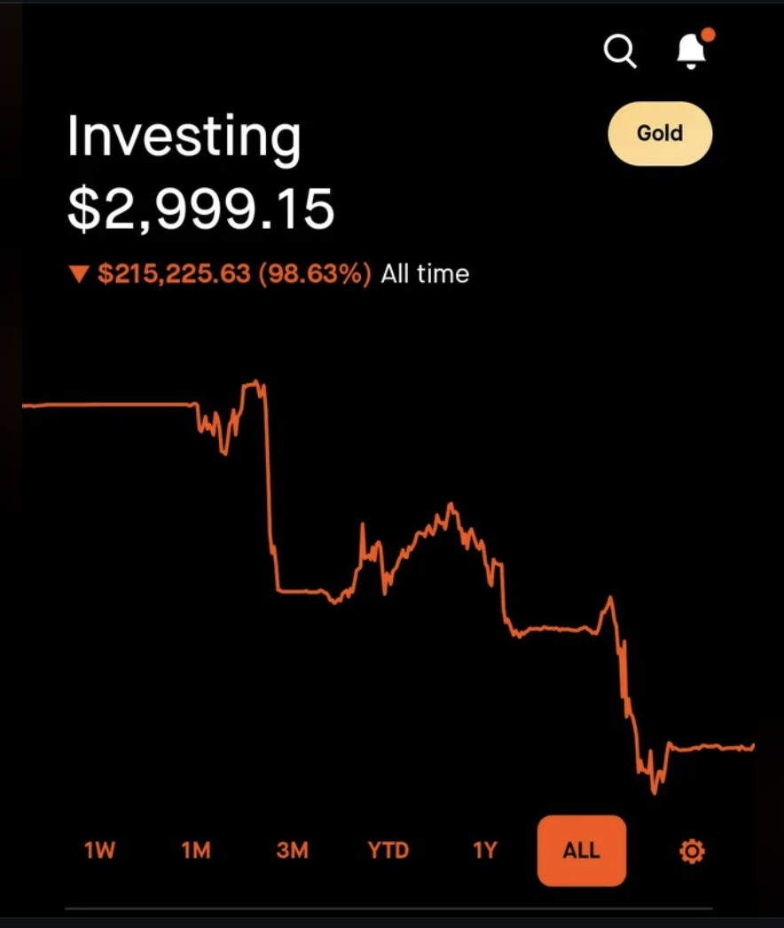
Hedge Funds Systematic Trading
Retail

Slide 3

Core Problem
What’s the smartest way to invest & trade?
How do you come up with your strategies?
Where do you find your ideas?
Quantitative strategies require weeks of reading, coding, and testing
This slows innovation and blocks non-experts.

Slide 4
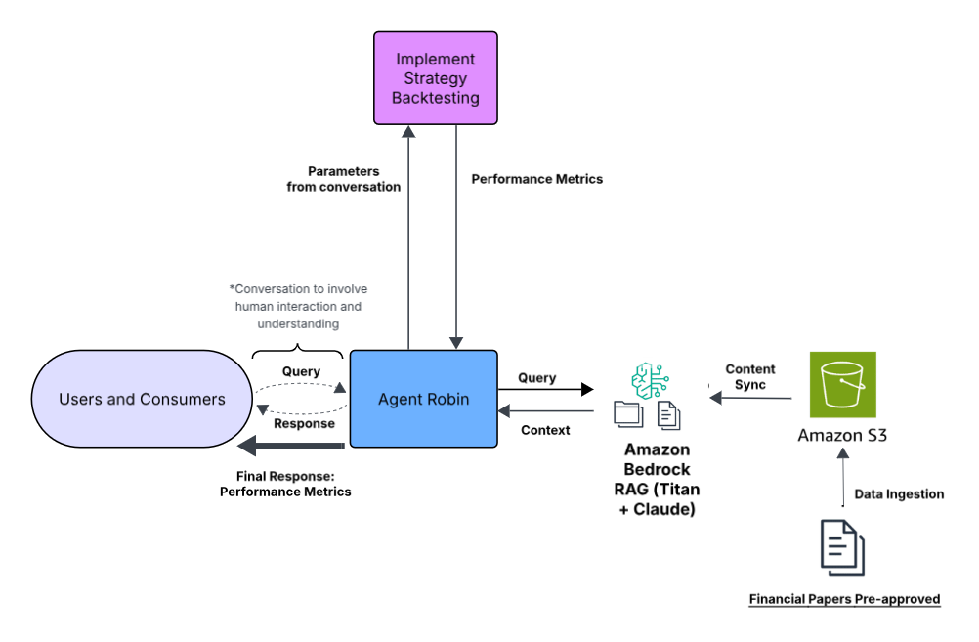
Notes:
Diagram made in Lucid Charts inspired by Amazon Bedrock Diagram https://render.skillbuilder.aws/?module_id=WRW8YQ4QGG%3A001.000.000&product_id=SC2Y3HMAUE%3A004.000.000&registration_id=0a5110d9-33ec-567a-88fd-f1484763fbcd&referrer=https%3A%2F%2Fskillbuilder.aws%2Flearn%2F63KTRM86DQ%2Famazon-bedrock-getting-started%2FSC2Y3HMAUE&navigation=digital

Slide 5
Notes:
Diagram made in Lucid Charts inspired by Amazon Bedrock Diagram https://render.skillbuilder.aws/?module_id=WRW8YQ4QGG%3A001.000.000&product_id=SC2Y3HMAUE%3A004.000.000&registration_id=0a5110d9-33ec-567a-88fd-f1484763fbcd&referrer=https%3A%2F%2Fskillbuilder.aws%2Flearn%2F63KTRM86DQ%2Famazon-bedrock-getting-started%2FSC2Y3HMAUE&navigation=digital

Slide 6
Notes:
Diagram made in Lucid Charts inspired by Amazon Bedrock Diagram https://render.skillbuilder.aws/?module_id=WRW8YQ4QGG%3A001.000.000&product_id=SC2Y3HMAUE%3A004.000.000&registration_id=0a5110d9-33ec-567a-88fd-f1484763fbcd&referrer=https%3A%2F%2Fskillbuilder.aws%2Flearn%2F63KTRM86DQ%2Famazon-bedrock-getting-started%2FSC2Y3HMAUE&navigation=digital

Slide 7
Notes:
Diagram made in Lucid Charts inspired by Amazon Bedrock Diagram https://render.skillbuilder.aws/?module_id=WRW8YQ4QGG%3A001.000.000&product_id=SC2Y3HMAUE%3A004.000.000&registration_id=0a5110d9-33ec-567a-88fd-f1484763fbcd&referrer=https%3A%2F%2Fskillbuilder.aws%2Flearn%2F63KTRM86DQ%2Famazon-bedrock-getting-started%2FSC2Y3HMAUE&navigation=digital

Slide 8
Innovation
Automated research-to-strategy translation
Conversational parameter design - no coding skills required, fast responses
Bedrock RAG grounding → verifiable citations
Modular for equities, crypto, futures, etc.
Works with any RAG corpus (scalable via S3 ingestion)

Slide 9

Market & Business
Democratizes quantitative investing
Addresses $50 B quant research and strategy automation market
Enables smaller funds and retail quants to compete with institutional tools
Cost Effectiveness / ROI
Cuts research-to-execution time from weeks → minutes = massive ROI for any research team.
Serverless= pay-as-you-go, costs are extremely low when idle.

Slide 10
DEMO + Future

